Slide 1

Project Title -Seasonal_Agriculture_Performance _Analysis
Student Name : Vanaparthy Ruthwik
College Name: Vaagdevi College Of Engineering
AICTE STU ID: STU6a2ed4dd302bc1781454045

Slide 2

PROBLEM STATEMENT
Agricultural performance varies across seasons, crops, regions, and environmental conditions.
Farmers need to understand which seasons provide better yield and profitability.
Different levels of rainfall, temperature, soil moisture, and resource usage can affect crop performance.
Large agricultural datasets are difficult to analyze manually.
There is a need for data-driven analysis to identify seasonal patterns, relationships, and unusual observations.
The project aims to analyze these factors and provide evidence-based insights for better agricultural planning.

Slide 3
Project Description:
This project analyzes agricultural data across different seasons such as Kharif, Rabi, and Zaid.
The dataset contains information about crops, geographical regions, farming conditions, environmental factors, resources, production, revenue, cost, and profit.
Data preprocessing and cleaning techniques are used to improve data quality.
Exploratory Data Analysis (EDA) is performed to understand important patterns and trends.
Seasonal performance is compared using yield, production, revenue, cost, and profit.
Crop-wise and region-wise performance is analyzed.
Relationships between environmental factors and crop yield are studied using correlation analysis.
Statistical techniques such as ANOVA and Tukey HSD are used to compare seasonal performance.
The final results provide insights for seasonal crop planning and efficient resource allocation.

Slide 4

WHO ARE THE END USERS?
Primary End Users:
Farmers – To select suitable seasons and crops based on historical performance.
Agricultural Planners – To plan seasonal farming activities and resource allocation.
Agricultural Officers – To understand regional and seasonal agricultural trends.
Agricultural Researchers – To study relationships between environmental conditions and crop performance.
Other Users:
Government Agricultural Departments – For data-driven agricultural planning.
Agribusiness Organizations – To understand production and profitability patterns.
Agricultural Analysts – To perform further analysis and decision-making.

Slide 5
Technology Used
Programming & Platform
Python.
Google Colab.
Jupyter Notebook.
Python Libraries
Pandas – Data loading, cleaning and analysis.
NumPy – Numerical operations.
Matplotlib – Data visualization.
Seaborn – Statistical visualization.
SciPy – Statistical analysis.
Statsmodels – Statistical testing.

Slide 6
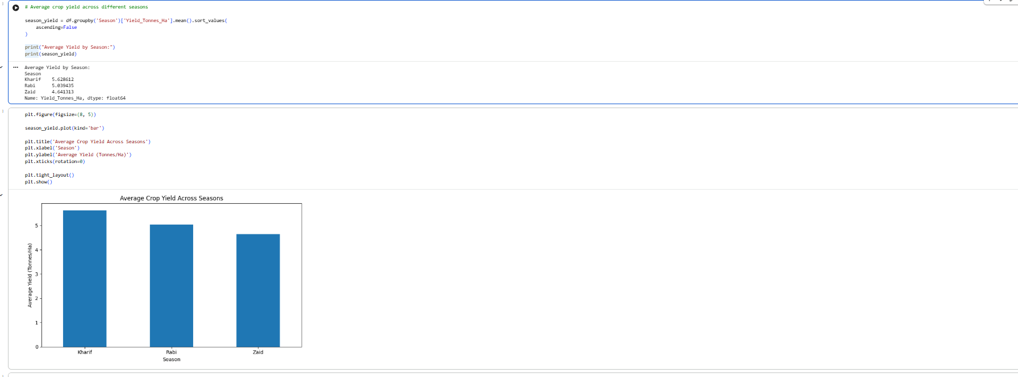
RESULTS

Slide 7
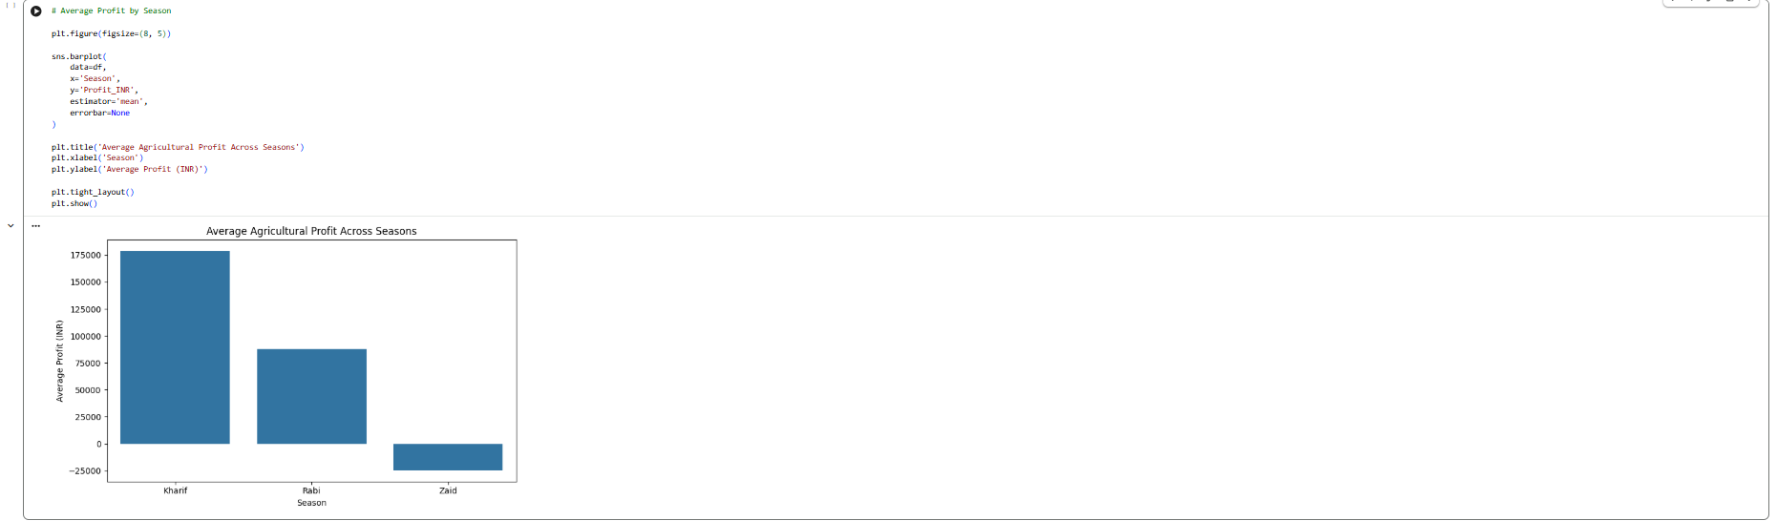
RESULTS
[Add screen shots of your code ]

Slide 8
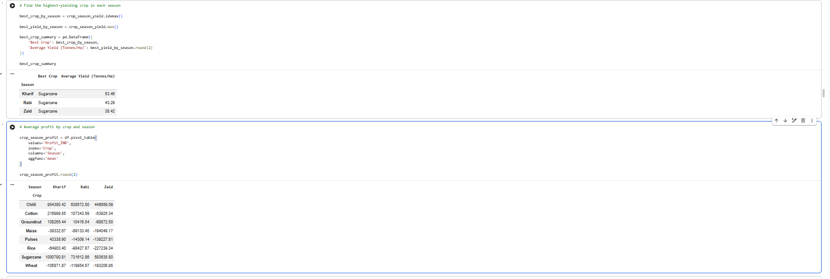
RESULTS
[Add screen shots of your code ]

Slide 9
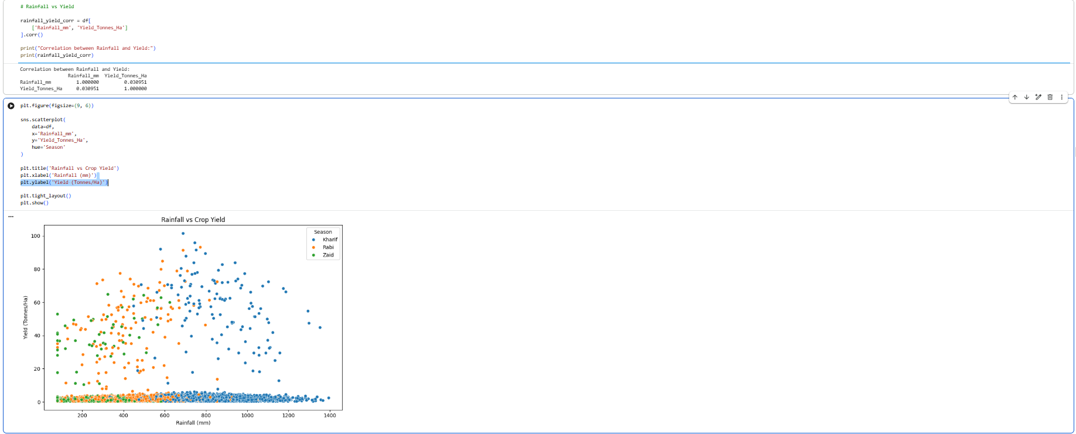
RESULTS
[Add screen shots of your code ]

Slide 10
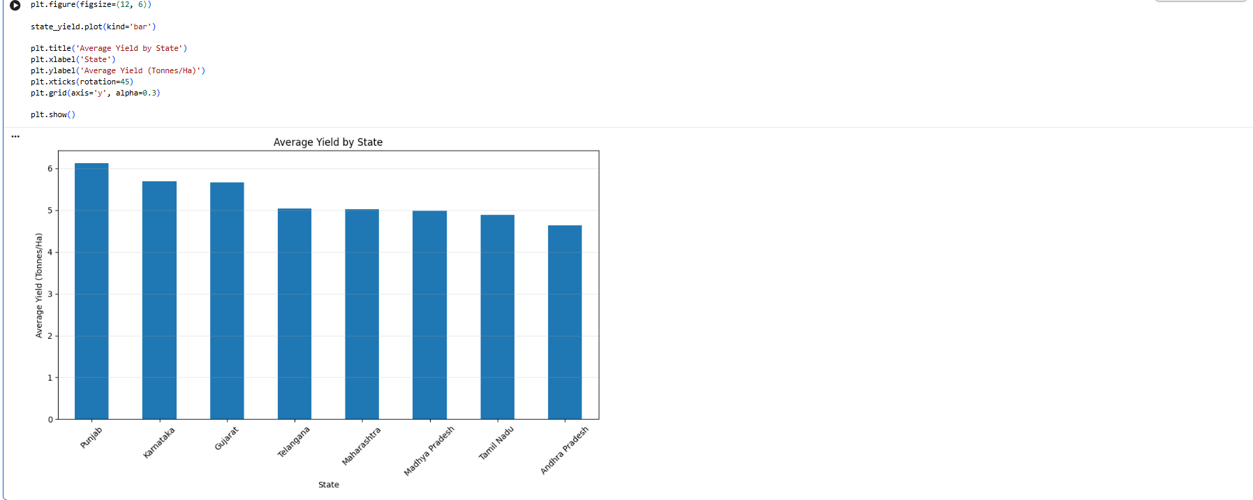
RESULTS
[Add screen shots of your code ]

Slide 11
Future scope:
Develop a real-time agricultural dashboard for monitoring seasonal performance.
Integrate weather APIs for real-time rainfall and temperature information.
Use Machine Learning to predict crop yield.
Develop a crop recommendation system based on soil and environmental conditions.
Add market price prediction to estimate future profitability.
Integrate satellite and remote-sensing data for advanced agricultural monitoring.
Develop a mobile application for farmers and agricultural officers.
Provide regional and personalized recommendations based on farm conditions.
Use historical data to identify climate-related agricultural risks.
Extend the system with AI-based decision support for sustainable farming.

Slide 12
GitHub Link
https://github.com/vanaparthyruthwik-maker/Seasonal-AgriculturePerformanceAnalysis.git

Slide 13
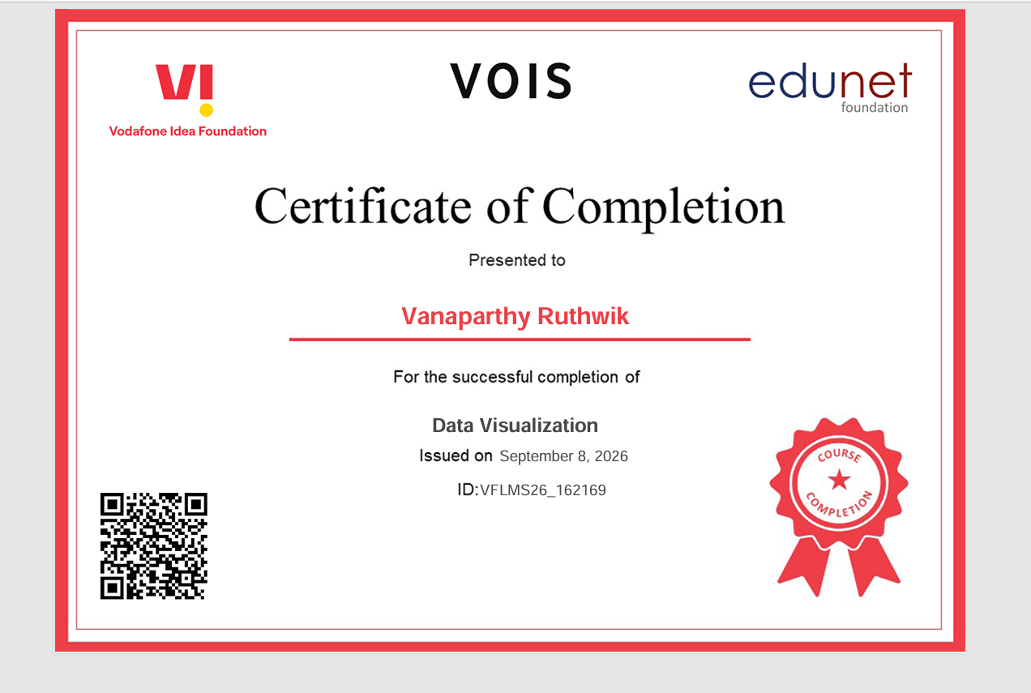
VOIS Course completion certificate -
Course name- Data Visualization

Slide 14
Thank you
.
.

